Slide 1
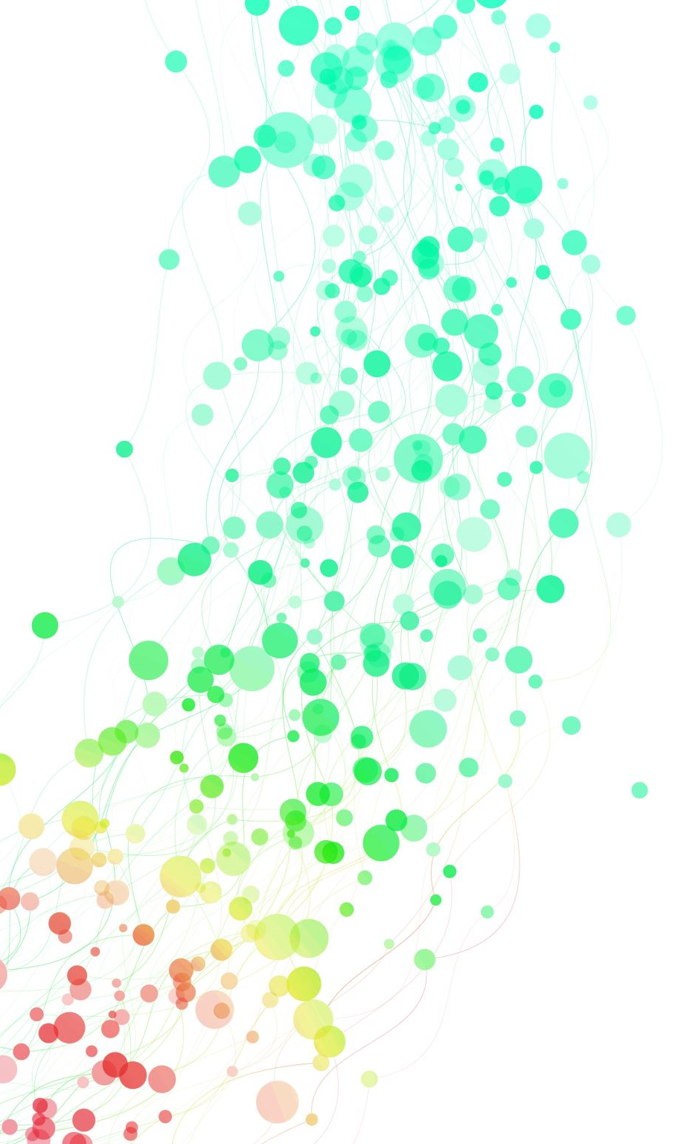
PROPOSAL DEFENCE ON [MOVIE TICKET BOOKING SYSTEM]
PRESENTED BY :
DIPIN POKHREL
PRAJWOL DANGOL
HARI NARAYAN CHAUDHARY
PRADIP RAMTEL

Slide 2
INTRODUCTION
Background and Problem statement:
The entertainment industry has transformed with technology, improving the movie ticket booking experience.
Online platforms have replaced traditional methods, eliminating queues and saving time for users.
Despite the availability of various online movie ticket booking platforms, there are still certain issues
Limited Availability Information
Inconsistent User Experience

Slide 3
Objectives and scope
To make easy to book ticket at home and form anywhere without visiting cinema and waiting in a long queue
This project we have carried out was a learning curve for us in development of such systems
In future we can scale this project by adding different dynamic interfaces for different mobile
Applications
Enhances customer satisfaction with a user-friendly platform
Secure online payments reduce counterfeit ticket risks
Convenient browsing of movies, show timings, and seat selection

Slide 4
LITERATURE REVIEW
Online movie ticket booking system offers a centralized platform for users to access information about new movies, schedules, cinema locations, classes, and ticket prices
BookMyShow is a well-known online movie booking system that has gained popularity since its establishment in 1999, receiving awards for its customer experience
Golden Village Pictures (GVP) is a leading film distributor in Singapore, known for its modern multiplex cinemas and personalized movie-going experience through its Movie Club program
These systems typically utilize responsive web design with backend support from technologies like PHP and SQL for database connectivity
Challenges in online movie ticket systems include handling high traffic and ensuring scalability to meet increasing demand

Slide 5
To Be Continue….
In Nepal, multiplex cinemas such as QFX, Big Movies, and Fcube offer online ticket reservation and payment options through popular online payment portals like Khalti, IME Pay, and eSewa
Features like user reviews, movie trailers, merchandise shops, and voucher code options are commonly found in online movie ticket booking systems
The system aims to enhance the overall movie ticket booking experience by providing convenience, accessibility, and additional features for users
Ongoing advancements in technology and customer expectations continue to shape the evolution of online movie ticket booking systems

Slide 6
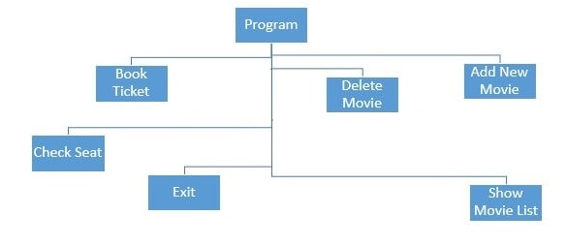
METHODOLOGY
The methodology employed for our project follows an iterative and incremental approach
System Design
Fig: Block Diagram

Slide 7
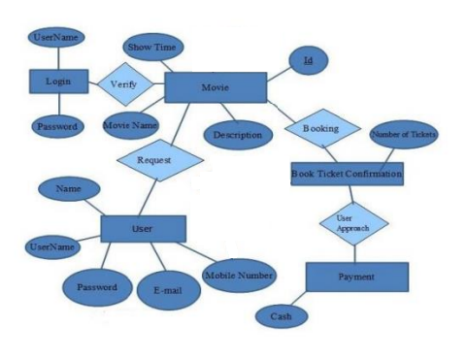
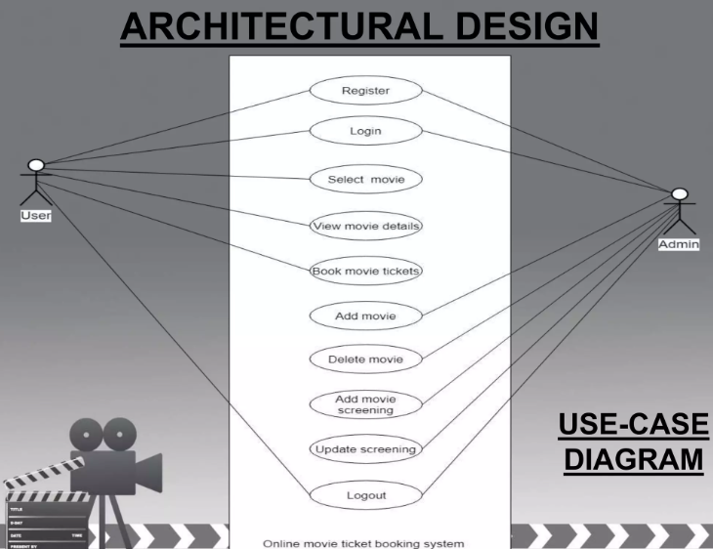
Fig: E-R Diagram Fig: use-case Diagram

Slide 8
Assumption
Real-time seat availability information is assumed to be available, preventing double bookings
The user interface is designed to be user-friendly and responsive across different devices
Users are expected to have a stable internet connection for accessing the system
Hardware and software required
Hardware Requirements:
Intel core i3 2nd generation is used as processor because it is faster & provide reliable and stable working environment
Software Requirements:
Any latest Operating System like Windows, Mac, linux
Browser, IDE like sublime, visual studio code
To store and manage data. Popular choices include MySQL

Slide 9
Implementation Plan
Using XAMPP with Apache server
Frontend written in HTML and CSS
Backend powered by Python and MySQL database
Admin panel for managing movie details, theaters, and ticket prices
Customer panel for theater listings, movie browsing, and ticket booking
Expected Outputs
Movie Listing: Display movies with title, genre, and poster
Showtimes: Present options with date, time, and available seats
Seat Selection: Show interactive seating layout and highlight available seats
Booking and Payment: Generate confirmation page with movie, showtime, and selected seats. Provide payment interface for transaction completion.

Slide 10
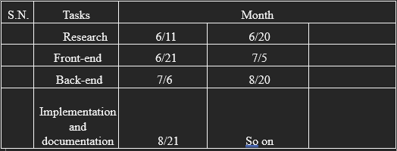
FEASIBILITY ANALYSIS
Schedule
Phase 1: 10 days for research and planning to understand project requirements.
Phase 2: 15 days for front-end development, focusing on user-friendly design.
Phase 3: 15 days for back-end development, ensuring robust functionality and integration.
Total project duration estimated at 40 days, including development, documentation, and testing.

Slide 11
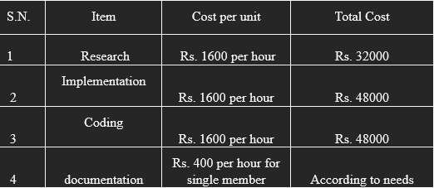
Financial Plan
Total project duration estimated at 40 days, including development, documentation, and testing.
Cost estimation: Rs. 400 per hour.
Project duration: 40 days.
Team members: 4.
Daily cost: Rs. 3200 (2 hours per day).
Projected budget: Rs. 128,000 (Rs. 3200 x 40 days x 4 team members).
Transparent and clear cost estimation for budget allocation.

Slide 12
Technical Feasibility
Skilled development resources available
Robust hosting infrastructure for scalability
Strong security measures implemented
User-friendly interface
Thorough testing and quality assurance
Ongoing maintenance and support planned
Operational Feasibility
Confident in successfully executing the project within defined parameters
Ongoing hosting and domain costs for maintenance
User-friendly interface for easy use by all users
Technical knowledge required for administrative operations
Costs associated with technical resources for system operation and administratio

Slide 13
Thankyou !

